Slide 1
Introduction to Reinforcement Learning

Slide 2
Agenda
Introduction
A brief History of AI
AI, ML, DL, RL and Big Data
Introduction to RL
How does it work ?
Actor – Critic model
RL Challenge

Slide 3
A BRIEF HISTORY OF AI

Slide 4
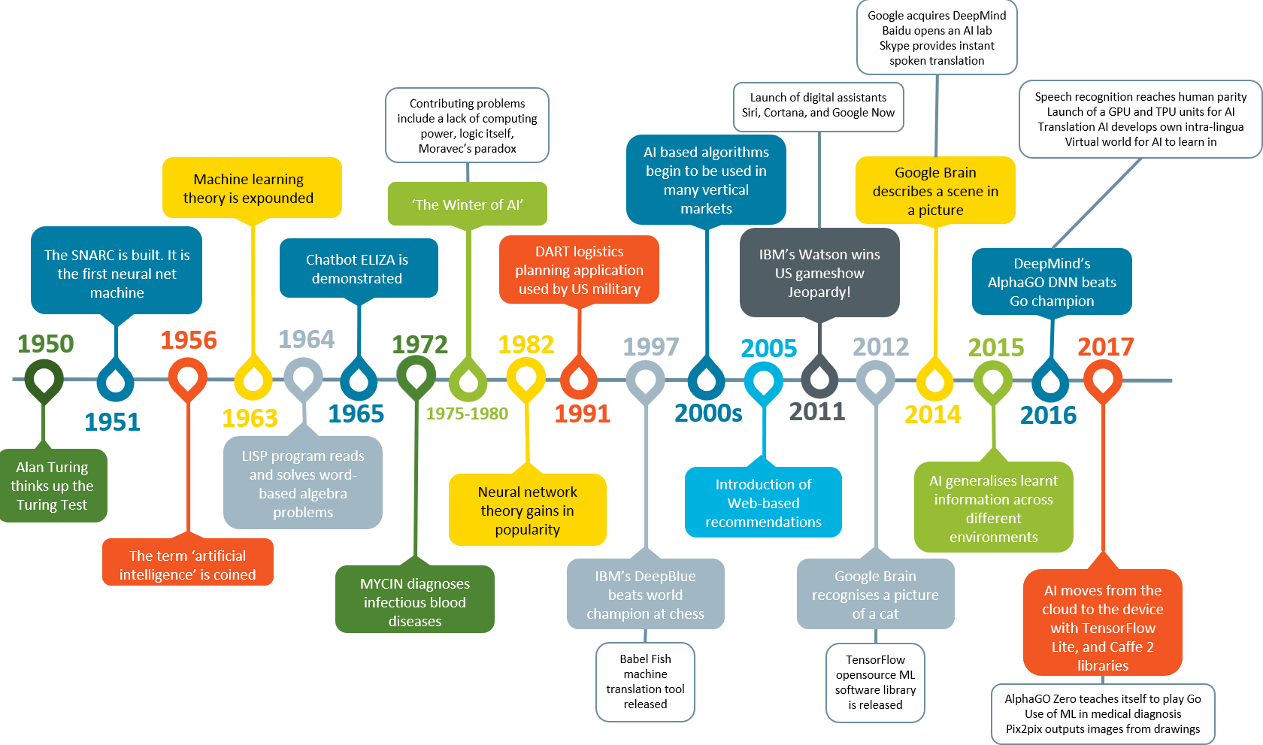

Slide 5
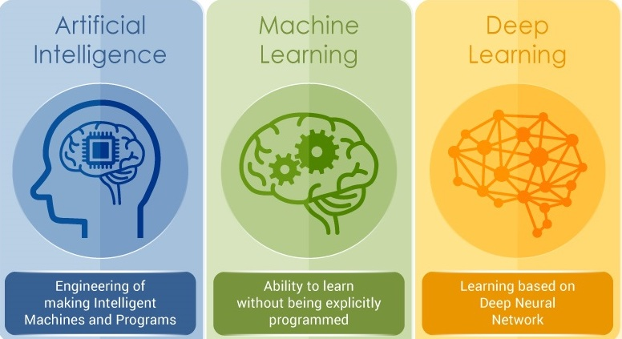
AI, ML, DL, RL and Big Data

Slide 6
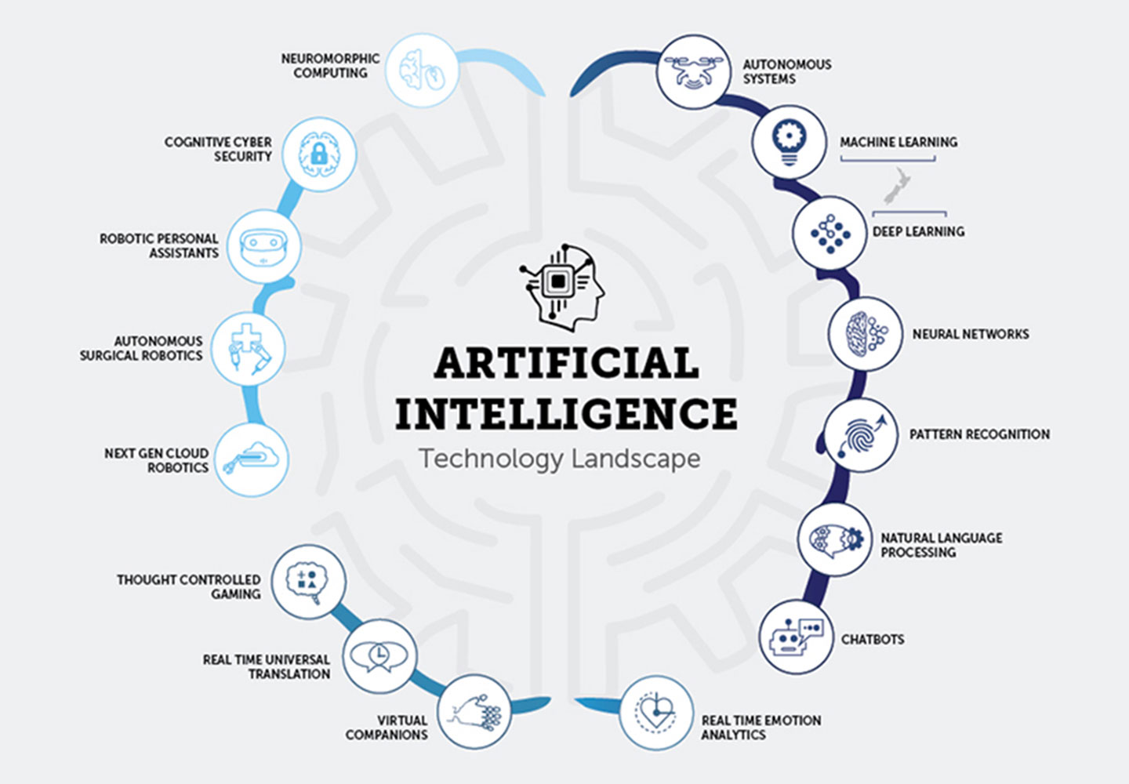
WHAT
IS
ARTIFICIAL
INTELLIGENCE ?

Slide 7
AI, ML, DL, RL and Big Data

Slide 8
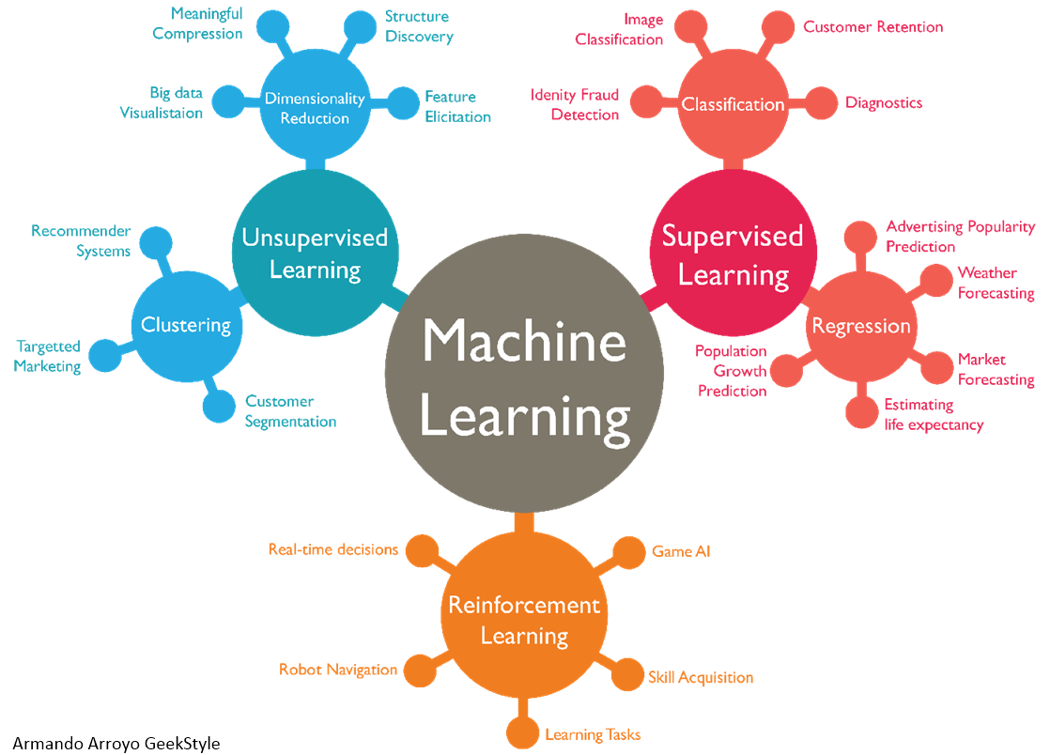
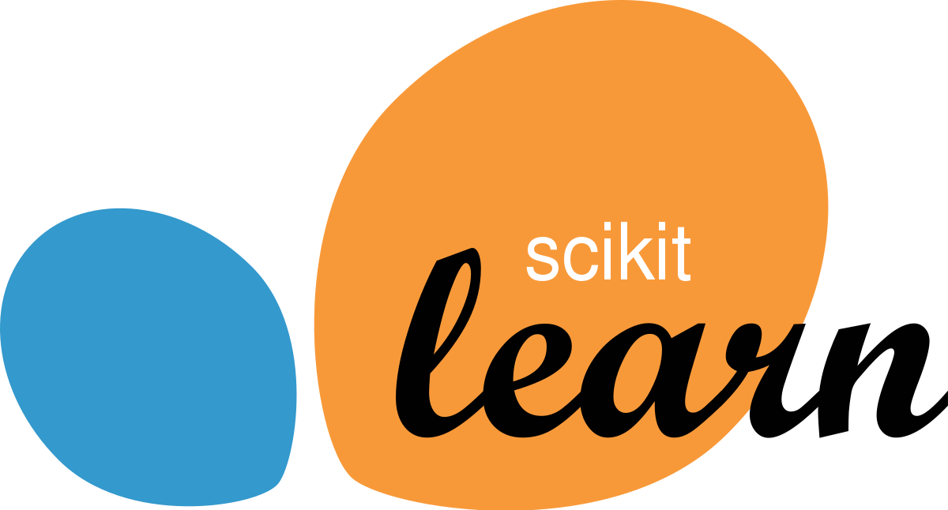




Slide 9
AI, ML, DL, RL and Big Data

Slide 10


Slide 11
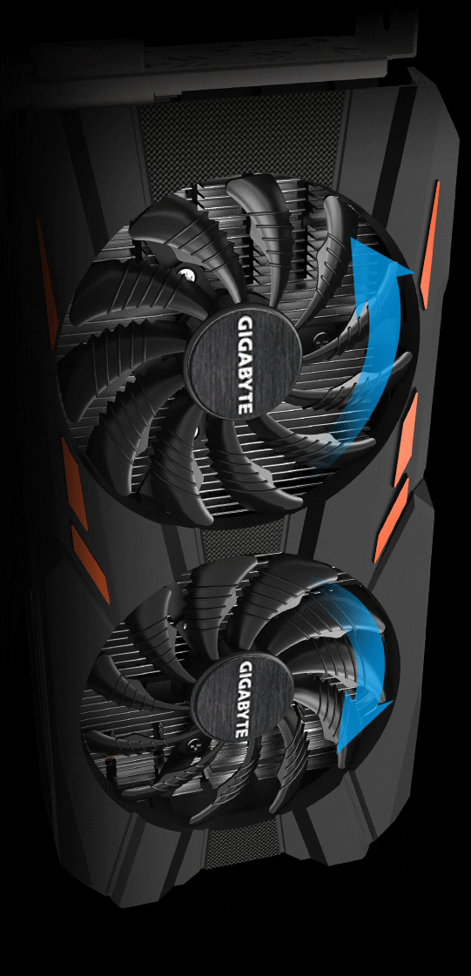

Slide 12
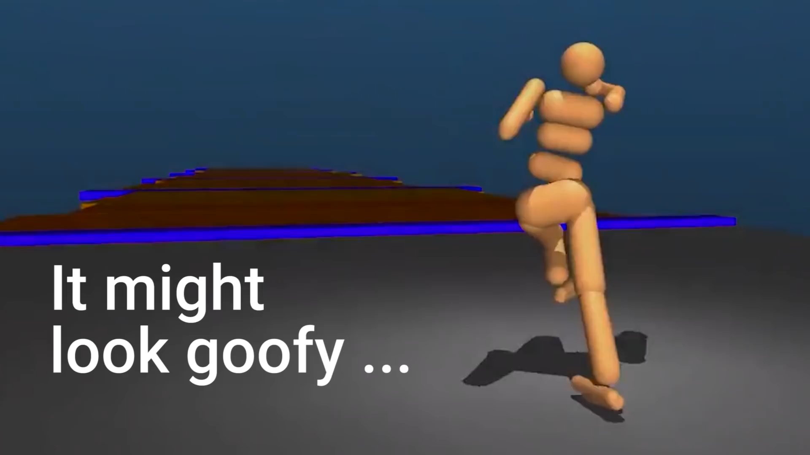
Humanoid learn to walk using RL

Slide 13
Reinforcement Learning is nothing but learning from mistakes

Slide 14


Slide 15
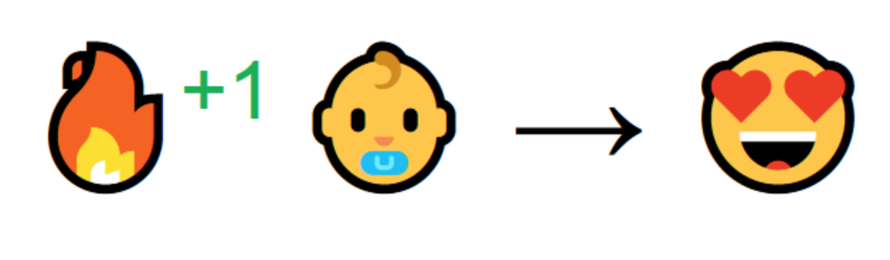

Slide 16
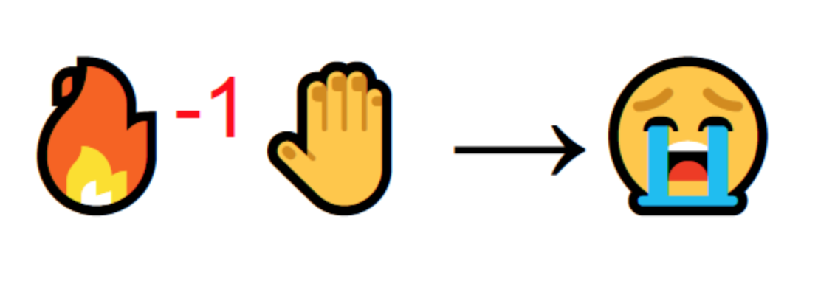

Slide 17
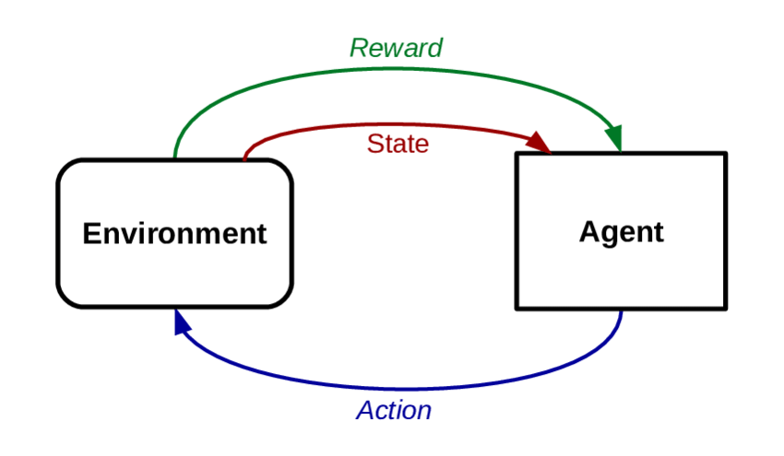
Introduction to Reinforcement Learning

Slide 18
REINFORCEMENT LEARNING

Slide 19
89,526,124
Whoa! That’s a big number, aren’t you proud?

Slide 20

THANKS!
Any questions?

